Slide 1
Cross-Platform Mobile Application Development with Xamarin
Module 3, Lesson 12:
Mobile Apps with Microsoft Azure App Service

Slide 2
Topics
Microsoft Azure
Azure App Service
Cloud-based mobile enterprise features

Slide 3
Objectives
By the end of this lesson you should understand:
The value of adding pre-configured common mobile functionality
The functionality that can be added to mobile apps via App Service
Interconnection between different kinds of apps in App Service

Slide 4
What is Microsoft Azure App Service?
Part of Microsoft Azure
Step by step, browser-based process
Adds features to web and mobile apps
Generates backend and frontend apps pre-configured for Azure
Automates creation of common mobile and web functionality
Can save development time
Generated pre-configuration can save time
Developers can focus on unique parts of app
Notes:
Notes:
App Service aims to automate the creation of very common line-of-business mobile and web functionality
By following the step-by-step wizard-like process in App Service in the browser, you can add common functionality that’s pre-configured to work with your Azure instance and other apps and services you’ve built in your Azure instance
The developers can focus on developing the parts of the app that are unique as opposed to the boilerplate, typical scenarios that must be re-created for each application

Slide 5
Microsoft Azure App Service Apps
Web applications
Mobile applications
Logic applications
API applications
Notes:
Notes:
These are the kinds of applications that can be built through App Service
The following slides will explain each kind of application

Slide 6
Web Applications in App Service
Provides a place to host your web application
Publish to your site via Visual Studio or FTP
Can work with many languages
Automatically scales up or down based on traffic
Continuous integration with many services
Notes:
Notes:
The web applications in App Service was previously offered under the name Azure Websites
Creating a Web App in App Service does not generate code. It creates a website location to which you can publish your actual website you write. You can publish to this web application via Visual Studio or through the file transfer protocol (FTP). More on FTP: https://en.wikipedia.org/wiki/File_Transfer_Protocol
The available languages are C#, Java, NodeJS, PHP and Python
If your traffic is volatile – such as during marketing campaigns – then new servers will be added to your plan when necessary and shut down when not needed
Continuous integration is the process of integrating your code (potentially along with the code of other members of your team) into a shared location on a routine basis (whenever a task is complete, at the end of the day, etc.). When your code is pushed into the shared location, build processes or unit tests can be run. If a build or unit test fails, you or the members of your team can be alerted. More on continuous integration: https://msdn.microsoft.com/en-us/library/ee308011(v=vs.100).aspx
App Service provides continuous integration with many services including Visual Studio Online, Git, GitHub and BitBucket

Slide 7
Mobile Applications in App Service
Automatically scales up or down based on traffic
Continuous integration with many services
Downloadable apps pre-configured to use your services
Native app for each major device
Cross-platform using Xamarin or Cordova
Notes:
Notes:
The mobile applications in App Service was previously offered under the name Azure Mobile Services
Using Microsoft Azure App Service, one can create starter mobile apps with initial code to start performing common tasks, including many cloud-based tasks. Many of these things involve common, boilerplate code that is included out of the box to jump start development on typical web and mobile tasks. These starter apps can be downloaded in native code for a particular device or in a cross-platform framework like Xamarin or Cordova
The available languages are C#, Java, NodeJS, PHP and Python

Slide 8
Logic Applications in App Service
Automates workflows and business processes
Wizard-like designer or through JSON file
Can listen to events or run on a timer
When a request is made to your app
When an event happens in a connected app
Respond to events with actions
Responses can happen in connected apps
Notes:
Notes:
Using the step-by-step wizard in Azure App Service, a logic app can be created. This logic app can respond to events that happen in connected apps. The response can also be via a connected app or it could be a generic web response
The events to which your app can listen include when someone uses it, when a file is added to a connected DropBox account, when an object is created or modified in SalesForce, when a message is received on a connected Azure Service Bus and when an item is created or modified in a connected SharePoint app, among many others
You can also trigger an action on a configurable timer
The ways that your app can respond include making an HTTP request, create a file in a connected AzureBlob account or a connected Google Drive account or a connected SharePoint app, among many others

Slide 9
API Applications in App Service
Downloadable backend API app
Starter APIs can be modified and published to Azure
C#.NET, Node or Java
Downloadable client app to use your backend API app
C#.NET, Node or Java
Can also connect to API apps in the Azure Marketplace
Notes:
Notes:
Following a wizard-like, step-by-step process in App Service, you can create a sample API backend and download it
You can then download a client that is pre-configured to consume the API created in the previous step. This client app can be in C#.NET, Node or Java
Azure Marketplace to be explained in the next slide

Slide 10
Azure Marketplace
Online store for Azure-configured apps and services
May have components for your app to use or include
API services and apps for many enterprise-level services
Azure Active Directory-connected apps
Notes:
Notes:
Some of the items in the store are free and some are available for a fee. The fees charged can also be based on the level of service, frequently revolving around volume of use
The items in the store are pieces of a larger or enterprise-level app that may be helpful
Email sending/management with SendGrid or Office365
Enterprise-level third-party integration with services like SharePoint, SalesForce and QuickBooks
API access for enterprise-level data services like Bing Search or Global Address Validation
Some items are entire Azure-configured applications or content management systems (CMSes) like WordPress, Umbraco, Drupal, etc.
This can speed up the application development process and save time and money
Most of the items in the Azure Marketplace are built with cloud-computing and Azure in mind, removing some of the common Azure-related development tasks
Azure Active Directory is Microsoft’s multi-tenant, cloud-based directory and identity management service. It provides single sign on access to all integrated apps and services. It includes identity management functionality such as multi-factor authentication, password management, role based access control, auditing and security monitoring and alerting
More on the Azure Marketplace: https://azure.microsoft.com/en-us/marketplace/

Slide 11
App Service Enterprise Features

Slide 12
App Service Enterprise Features
Push notifications
Authentication, authorization
Easy tables
Easy APIs
Notes:
Notes:
You can add enterprise features to your app through App Service via a step-by-step, wizard-like setup process
After creating a web or mobile app or backend, you can then add features to it
The four features on this slide will be explained in the subsequent slides

Slide 13
Push Notifications
Let app notify of messages or events, including when not in use
Available in mobile apps, web apps and API apps
App Service allows for connecting to many providers:
Apple
Google
Windows
Windows Phone
Amazon
Baidu
Notes:
Notes:
Push notifications can occur whether or not an application is in use
Push notification capabilities include connecting to Apple, Google, Windows, Windows Phone, Amazon and Baidu
Must enter proper authentication credentials (such as an API key for Google) and then the feature will be added to your downloadable apps with sample usage
The wizard-like, step-by-step process can help set up push notifications for web, mobile and API apps in App Service

Slide 14
Authentication, Authorization
Authentication verifies who you are
Authorization verifies what an authenticated user can do
Available in mobile apps, web apps and API apps
App Service can integrate with many providers:
Azure Active Directory
Twitter
Facebook
Google
Microsoft
Notes:
Notes:
Authentication and authorization capabilities include integration with Azure Active Directory, Twitter, Facebook, Google and Microsoft
This allows for people to use their accounts for each of these sites in lieu of creating an account just for your site or app
The wizard-like, step-by-step process can help set up authentication and authorization for web, mobile and API apps in App Service

Slide 15
Easy Tables
Available in mobile apps, web apps and API apps
Add an Easy Table through App Service
No code to write
Add, modify columns through App Service
Generated app will now have API support for this table
Properties of objects sent to an Easy Table map to columns
Missing columns are added
Notes:
Notes:
Easy Tables is a feature in App Service that allows for quick connection to an Azure-hosted table
You can create the table and modify its schema in the same wizard-like interface in App Service
When sending records to an Easy Table, any properties on the record are mapped to columns. Any properties that do not map to columns in the table will trigger an addition of a column with the same name as that property
References:
Walkthrough of Easy Tables: https://blog.xamarin.com/getting-started-azure-mobile-apps-easy-tables/

Slide 16
Easy APIs
Available in mobile apps, web apps and API apps
Add an Easy API through App Service
Edit script through Visual Studio Online, linked from App Service
Generated app will now have API support for this API
Notes:
Notes:
Easy APIs is a feature in App Service that allows for quick connection to an Azure-hosted API
You can create a blank API in the same wizard-like interface in App Service
To edit the API, you click on the “Edit script” in the API’s “blade” in App Service. Then Visual Studio Online opens in a new tab in your browser, editing a file that defines your API

Slide 17
Mobile Apps in Azure App Service

Slide 18
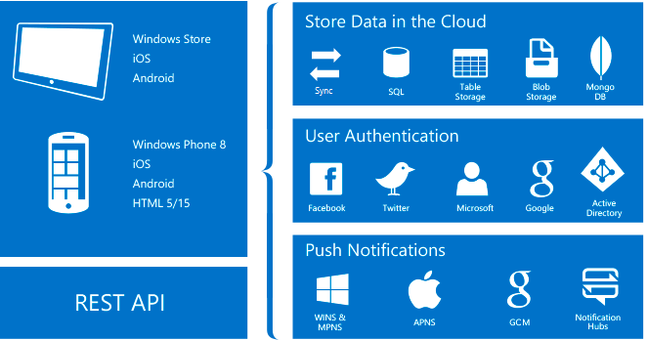
Data, Authentication, and Push Notifications
Notes:
References:
Image courtesy of Microsoft

Slide 19
How to Use Mobile Apps
Create a new Azure Mobile App backend
Build, upload, and test the server project
Create a client mobile application
Notes:
Notes:
Easy APIs is a feature in App Service that allows for quick connection to an Azure-hosted API
You can create a blank API in the same wizard-like interface in App Service
To edit the API, you click on the “Edit script” in the API’s “blade” in App Service. Then Visual Studio Online opens in a new tab in your browser, editing a file that defines your API

Slide 20
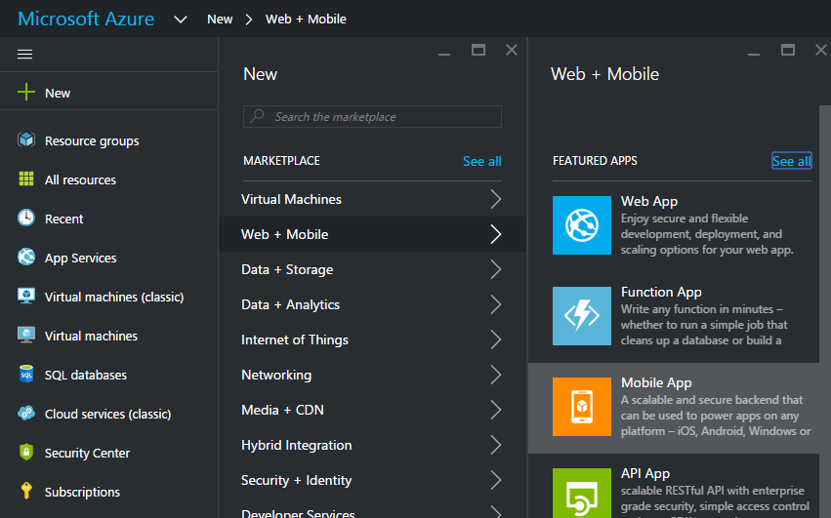
Create a new Azure Mobile App backend
Notes:
Notes:
Select New > Web + Mobile > Mobile App

Slide 21
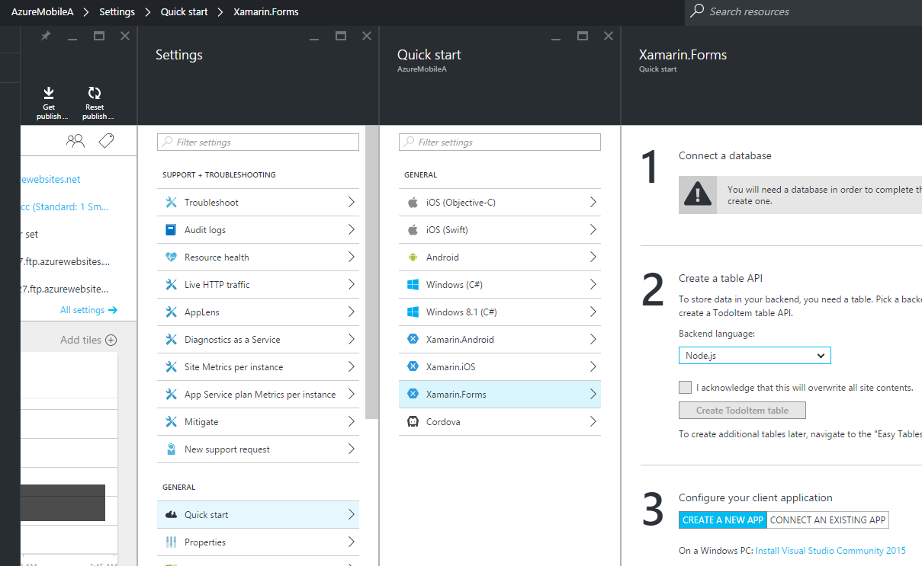
Quick Start in Settings and Connect a DB
Notes:
Notes:
Select New > Web + Mobile > Mobile App
1 Connect to a Database (create a DB connection)
2 Create a table API (C#)
3 Configure your client application

Slide 22
Create a Table API using C#
Step 2: Click Download
Open the extracted solution in Visual Studio
Build the project to restore NuGet packages
Deploy the project to Azure

Slide 23
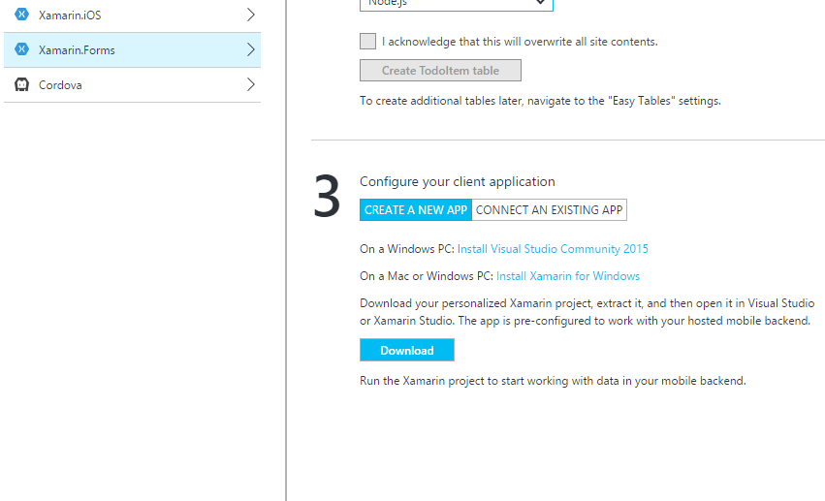
Create a client mobile application
Step 3, click Create a new app
Click the Download button
Open Solution in Visual Studio or Xamarin Studio
Notes:
Notes:
You can download the solution to a Mac and open it in Xamarin Studio, or you can download the solution to a Windows computer and open it in Visual Studio using a networked Mac for building the iOS app.
Extract the project that you downloaded, and then open it in Xamarin Studio or Visual Studio.

Slide 24
Summary
After completing this lesson, you should understand:
The value of adding pre-configured common mobile functionality
The functionality that can be added to mobile apps via App Service
Interconnection between different kinds of apps in App Service

